Slide 1
TU856-1 & TU858-1 Computer Architecture and Technology Module Code: CMPU 1006
Semester 1, Week 4
NUMBER BASES

Slide 2
Presentation Outline
This presentation is a quick look at number bases; namely, decimal, binary, octal and hexadecimal.
It will focus on the structure of the number bases, and how that structure relates to data storage.
There are some quick and simple examples of the mathematical aspects of the number bases – the use of Two’s Complement to manage minus calculations in a computer, for example.

Slide 3
Presentation Content - including
What is Information to a Computer?
Number Bases
Bytes
Binary
Binary Mathematics
Binary – Negative Numbers
Two’s Complement
Octal Number Representation
Octal Numbers and Bytes
Hexadecimal Number Representation
Hexadecimal Numbers and Bytes
Lecture Summary
Where to Next?

Slide 4
What is Information to a Computer?
A computer functions on electricity and magnetism. The magnetism is very often a product of electrical flow.
There is a great deal of light and reflection in modern hardware (lasers and fibre optics) but light is a medium generated by electrical flow.

Slide 5
What is Information to a Computer? (2)
Electricity in a computer circuit has voltages (DC - direct current):
@ +12 Volt for a disk drive,
@ + or -5 Volt or + or -3 Volt for buses and communications wiring,
@ 0.75 - 1.4 Volt for the processor (depending on the specification, clock speed...)

Slide 6
What is Information to a Computer? (3)
Whatever the voltage the flow can be switched on and off - or be present or absent.
Voltage on might equal a 1,
Voltage off might equal a 0. Binary!
All information (instructions, data, etc.) flows through the hardware system as 'Power On' or 'Power Off‘ - as 1s and 0s.

Slide 7
Decimal Numbers
Numbers are often represented in decimal form for our mathematical use.
This is the 'Base 10' number system and it is the number format that we, as humans, might feel most comfortable with.
Decimal is Base 10

Slide 8
Binary Numbers
Computing machines operate on electrical current and so use two states. We view these states as the numbers 0 and 1.
This is the binary representation and is called 'Base 2'.
Binary is Base 2

Slide 9
Binary Numbers (2)
All modern computers work with a system of numbers that are binary numbers.
The two symbols: 0 and 1.
Each is called a ‘bit’, short for ‘binary digit’.

Slide 10
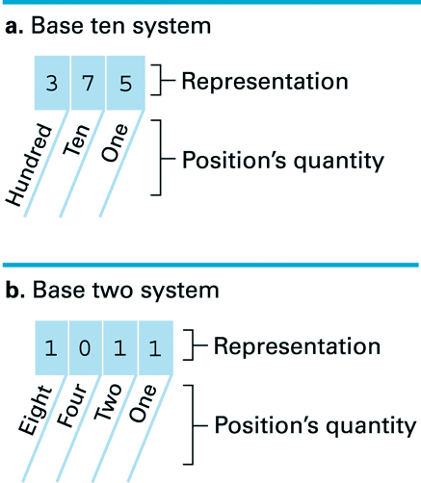
Numbers and Their ‘Bases’
Part b. of this diagram has 1011 in Base 2. That is equal to 11 in Base 10. (An eight plus no four is eight, plus a two is ten, plus a one is eleven.)

Slide 11
Decoding the Binary Representation 100101₂
Whether in decimal or binary, the position of numbers delineate their quantity.
The following diagram shows the number positions for binary 100101

Slide 12
1 0 0 1 0 1
This diagram shows how 100101₂ = 37₁₀.

Slide 13
Algorithm for Finding the Binary Representation of a Positive Integer
Step 1. Divide the value by two and record the remainder.
Step 2. As long as the quotient obtained is not zero, continue to divide the newest quotient by two and record the remainder.
Step 3. Now that the quotient of zero has been obtained, the Binary representation of the original value consists of the remainders listed from right to left in the order they were recorded.

Slide 14
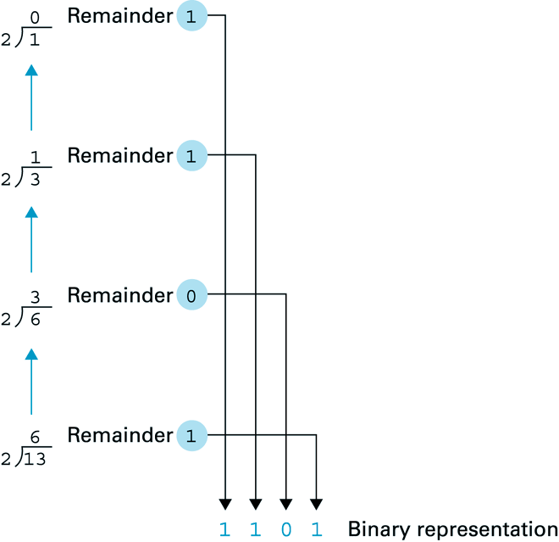
Obtaining the Binary Representation of 13₁₀

Slide 15
Bytes
A group of bits (binary digits), often eight, make up a ‘byte’.
A byte can represent a number in the range 0 – 9, or a letter of the alphabet or a symbol, such as * or ! or £…, when a binary 'byte' needs to be sent through the central processing unit for a calculation or for storage.

Slide 16
Bytes (2)
The highest representation for a number begins on the left side of the binary grouping - similar to how, in a decimal number, the position for 'hundreds' is left of the 'tens' position (which is left of the units).
The leftmost position in binary and decimal represents the height of the value of the number.

Slide 17
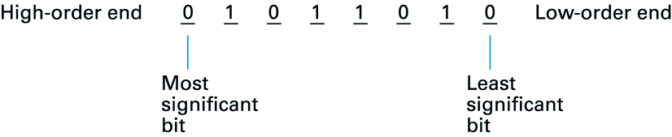
Bytes (3)

Slide 18
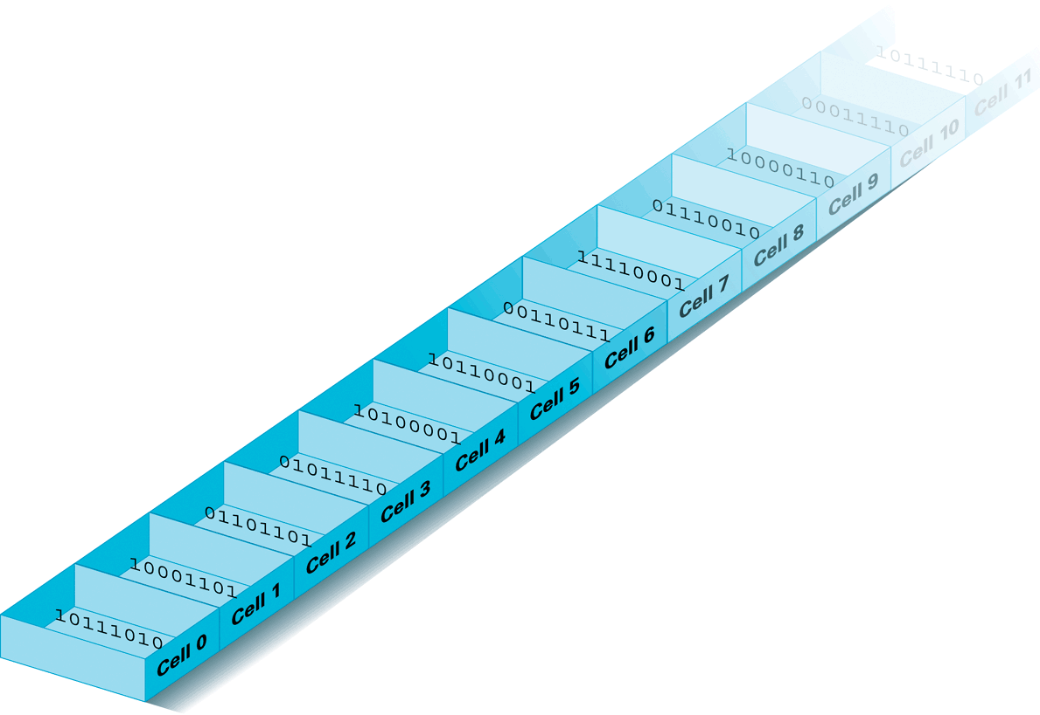
Bytes in Memory

Slide 19
Counting in Binary
Decimal
Each number has a unique representation
Counting:
When you run out of digits, make it a zero and increment the next place value to the left.
99₁₀ becomes 100₁₀
Binary
Each number has a unique representation.
Counting:
When you run out of digits, make it a zero and increment the next place value to the left.
11₂ becomes 100₂

Slide 20
Binary Mathematics
The fact that data are represented in binary allows a computer to convert numbers, as data elements, by the mathematical operations of programmed addition, subtraction, multiplication and division.

Slide 21
Binary Mathematics (2)
For binary machines (computers) it is usually impossible to do subtraction and division.
It is more feasible for binary numbers to be added to each other to allow any required conversion of a number – even when effecting a subtraction, multiplication or division. (This seems odd, but it is how ‘relay devices’ do (and must) work.

Slide 22
Binary Mathematics (3)
For that reason, the mathematics of binary are based on increments and decrements.
For example, 2 x 3 would be processed as 00000010 incremented by itself three times. That would be:
00000010
+ 00000010
+ 00000010
= 00000110 (00000110₂ = 6₁₀)

Slide 23
Binary Mathematics (4)
A binary addition example for single binary digits:
0 1 0 1
+0 +0 +1 +1
0 1 1 10 in Base 2

Slide 24
Binary Mathematics (5)
A 0₂ added to a 0₂ will equal 0₂
A 0₂ added to a 1₂ will equal 1₂
A 1₂ added to a 0₂ will equal 1₂
A 1₂ added to a 1₂ will equal 10₂

Slide 25
Binary Mathematics (6)
*** Note ***
Decrements in binary mathematics are achieved, not by simple subtraction, but by the addition of a negative number!
What!?
This is Two’s Complement – more on that next…

Slide 26
Two’s Complement
Negative numbers are represented, in binary, by Two's Complement.
To decrement in binary you find the Two's Complement for the number you wish to decrement by (or subtract) and ADD it to the number from which the subtraction must be made.

Slide 27
Two’s Complement (2)
This looks mad but it is the most efficient and reliable way to reduce the value of numbers (or to create a new number based on subtraction) when operating in binary number form.

Slide 28
Representing Negative Numbers
Here is an example of Two's Complement (or 2's complement). Let us say that we have a minus twelve (-12) in Base 10. Do we use 001100 in binary and put an ASCII value for - (the 'minus' sign, which is 0101101) in front of it or behind it?
No. Why? Because we would not be able to perform mathematical additions with that combination. It might be all right for representing a text label, but mathematics would not work.

Slide 29
Representing Negative Numbers (2)
So…
To convert 12₁₀ to 2’s complement using 6 bits (to represent -12₁₀):
Decide upon the number of bits n (6).
Find the binary representation of the +ve value in n-bits (001100₂).
Flip all the bits (change 1’s to 0’s and vice versa) (110011₂).
Add 1 (110100₂)
-12₁₀ = 110100₂

Slide 30
Representing Negative Numbers (3)
Why does this work?
Look at this:
13 (001101₂)
- 12 (110100₂) (binary for 12 in 2’s comp.)
= 01 (000001₂)

Slide 31
Representing Negative Numbers (4)
The proof is that you take the +13 and ADD the -12.
(001101₂)
+ (110100₂)
1(000001₂)
That last ‘1’ on the left gets 'pushed out' and is ignored.

Slide 32
Representing Negative Numbers (5)
What happened to 'Most Significant Bit' - as of the left-hand side? Well, in this case a pushed 1 becomes an 'INSIGNIFICANT Bit'.
As it happens, using a six-bit capacity means that it is not stored and goes nowhere. It disappears - ceases to exist - leaving the proper sum, the one you want, 000001, also known as 1₁₀.

Slide 33
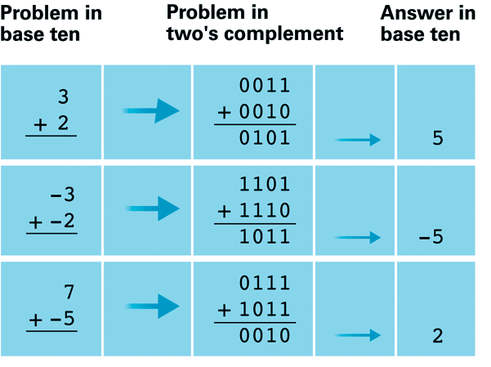
More 2’s Complement
Here are more examples for 2's complement:

Slide 34
Octal and Hexadecimal Number Bases
Octal and hexadecimal data types are integer types that are available in most computer languages.
All integer values (decimal numbers, with or without decimal places) are expressed in computer memory by setting the values of binary digits for that decimal number.
However, long binary digit sequences that represent large decimal numbers are difficult for us to deal with.

Slide 35
Octal Representation
Suppose that you wanted to write out the binary form of the decimal number, 9587. You should find that:
9587₁₀ = 10010101110011₂
The expression can be made more readable by grouping the digits.

Slide 36
Octal Representation (2)
Grouping the above binary digits into threes it looks like this:
9587₁₀ = |010|010|101|110|011₂
(Where the | is used as a divider between groups of three and a zero has been added to fill out the group on the left end.)

Slide 37
Octal Representation (3)
The octal notation for representing Binary numbers uses groups of three bits:
Note that the symbols that are used to represent each group are the same as the integer value of each group.

Slide 38
Octal Representation (4)
Continuing the Octal notation for Decimal numbers would look like this:
8₁₀ is 001 000 and is 10 in Base 8
9₁₀ is 001 001 and is 11₈
10₁₀ is 001 010 and is 12₈
11₁₀ is 001 011 and is 13₈

Slide 39
Octal Representation (5)
By using these Octal symbols (0 - 7), the number can be expressed in a more compact form:
9587₁₀ = (2|2|5|6|3) in Octal
That is to say…
|010|010|101|110|011₂ can be seen as:

Slide 40
Octal Representation (6)
Because the symbols are the same as those that are used in Base 8 counting, this is called octal notation.
We can write:
9587₁₀ = 22563₈

Slide 41
Hexadecimal Representation ('Hex')
Suppose that we group the binary digits into fours. Then this might be written:
9587₁₀ = |0010|0101|0111|0011₂
Now the groups of four can be given different symbols.

Slide 42
Hex Representation (2)
There are 16 different combinations of four binary digits.
The symbols chosen are the common numerals (0 - 9) and the remaining six possible four-bit combinations are represented by the letters, A, B, C, D, E and F.
(The letters may be either upper or lowercase.)

Slide 43
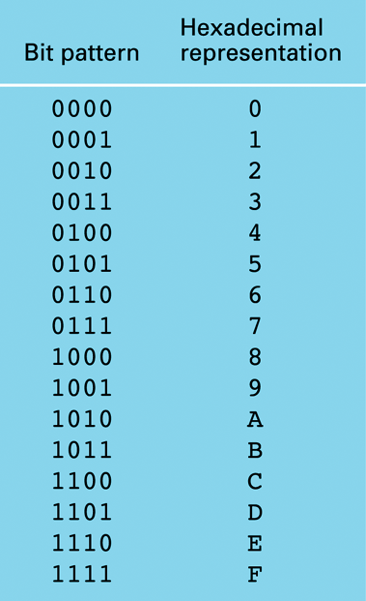
Hexadecimal Representation (3)
The Symbol Table:

Slide 44
Hex Representation (4)
With this notation we would write the Base 10 (decimal) number equal to the Base 16 number like this:
9587₁₀ = 2573₁₆
This is called the hexadecimal representation.

Slide 45
Hexadecimal Representation (5)
Proof:
|0010|0101|0111|0011₂

Slide 46
Hex Representation (6)
Hex (short for "hexadecimal") is very similar to octal in its relationship to binary. It just takes one more binary column to account for one Hex column.
Since the binary number 1111 equals Hex F, it follows that 1111 1111 binary equals Hex FF.

Slide 47
Hexadecimal Representation (7)
Hex has numerals going up to F so you have to be able add single digits up to F before carrying.
For instance, in decimal 7 + 4 would equal 11, and in octal it would equal 13, as in the octal examples above. In hexadecimal it equals B. (11₁₀ = 1011₂ = B₁₆)

Slide 48
Hex Representation (8)
To do these conversions in your head requires that you learn a new addition table (or figure it out on your fingers every time).
Hex is very commonly used in computers because exactly two Hex digits represents exactly eight binary digits, and eight bits are exactly one byte; a common unit of computer numbering.

Slide 49
Hexadecimal Representation (9)
Hexadecimal is easier for byte groupings.
Here are some more Hex representations:
15₁₀ is 1111 and is F in Base 16
16₁₀ is 0001 0000 and is 10₁₆
25₁₀ is 0001 1001 and is 19₁₆
183₁₀ is 1011 0111 and is B7₁₆

Slide 50
End of Number Bases
That describes the mathematical nature of the number bases of decimal, binary, octal and hexadecimal representation. There has been a strong hint that these number bases have practical applications for computer architecture.
Are there…
ANY QUESTIONS?

Slide 51
Where to Next?
NEXT WEEK:
The theme of the next lecture:
“Logic Gates”
How do binary numbers move inside a computing device? How are electrical signals used to ‘filter’ or change the states of bits? We can look at these things next.

Slide 52
Thanks for your attentiveness.
See you here next time. Be safe and well in the meantime.

